Slide 1
Data Science Salaries
Nelson Tran

Slide 2
Introduction to Analysis
Data collection plays an important part in data analysis.
Filtering out data with inadequate information will give a more accurate representation of a data science salary.
Information not needed will also be omitted.
Ie. Full-time employment is only considered in data analysis, compared to part-time or freelance work

Slide 3
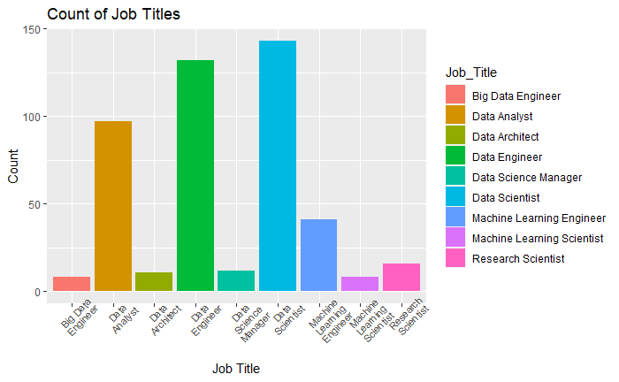
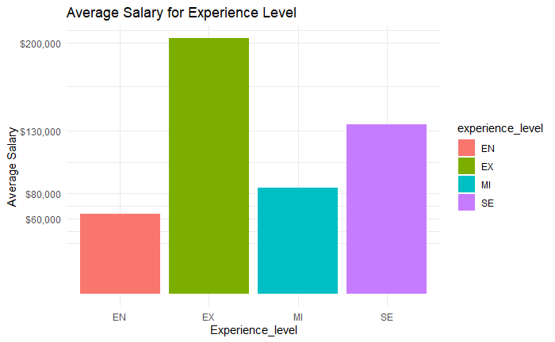
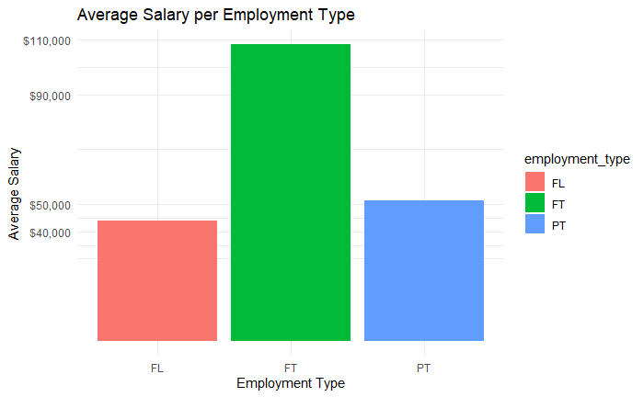
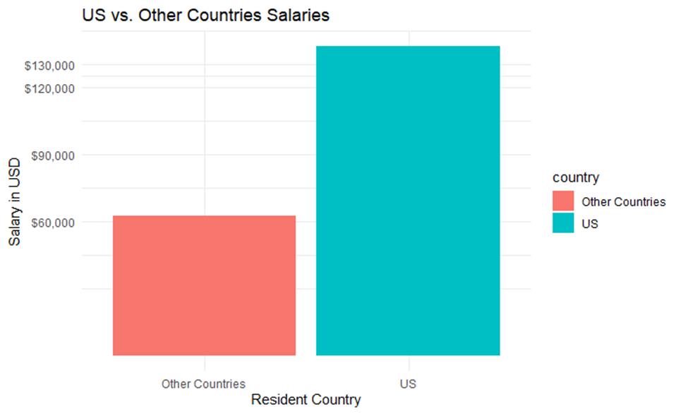
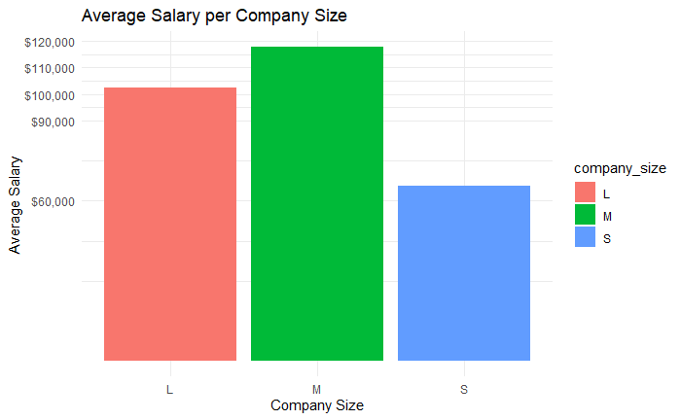
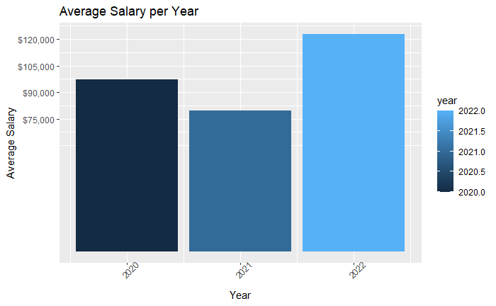
Data Cleaning
Notes:
First, filtering out job titles that have less than 7 data points. Secondly, data that we need to look at is the average salary for employee residence, experience level, employment type, company size, and yearly salary. Variables like remote ratio and company location do not need to be look at as closely because we are mainly looking at the variables shown in the graphs. From the data shown above, there is an outlier in experience level of executive level employees as there are only 6 data points. The new hire will be a full-time employee, we can filter out part-time and free lance work. After looking at the data, we can now take the average salaries per year from the different levels on experience.(entry level, mid level, and senior level)
Side Note: all salaries mentioned above is in USD.

Slide 4
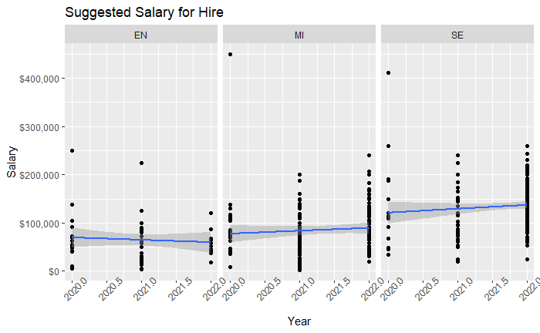
Suggested Salary for Hire
Notes:
A suggested salary for hire can be obtained from the scatter plot above. We can take this at face value, but we should also take into consideration of the country a potential employee could be residing in. From the previous slide, we can see that depending on where a potential candidate will be from, we can see that other countries compared to the US will be paid at about 50% of the salary of a US employee.
Side note: All salaries in USD

Slide 5
Conclusion
We can expect to pay employees in the US:
Entry Level: 70,000$ - 80,000$
Junior Level: 90,000$ - 100,000$
Senior Level: 130,000$ - 140,000$
We can expect to pay employees outside the US:
Entry Level: 40,000$ - 50,000$
Junior Level: 60,000$ - 70,000$
Senior Level: 90,000$ - 105,000$
Notes:
Salaries are all in USD. They include salaries that are going up due to the great recession and how competitive the market is. The salaries include the 3 experience levels because a team of data scientist might be considered in the future.

Slide 6
Thank you
Nelson Tran
Trannq@merrimack.edu

